Slide 1

Chapter 9
INFLATION
Updated 2024

Slide 2
Contents
The inflation concept – slide 2
The measurement of inflation – slide 3
Inflation data – slide 10
Headline and underlying inflation – slide 14
Types of inflation – slide 16
The effects of inflation – slide 19
Inflation news – 21
Review – 24

Slide 3
Inflation – Concept and definition
Inflation is a persistent and appreciable rise in the general level of prices.
That is, inflation sees prices rise noticeably across a range of goods and services over time.
Some level of inflation is ‘normal’ in developed economies.
Inflation data is an important indicator of the state of the economy.
Notes:
Inflation data is an important indicator of the ‘health’ of the economy.
Many observers believe that moderate inflation levels are beneficial because small price rises helps to drive consumption, and economic growth. Higher levels of inflation, however, have negative consequences for economic activity, decision-making, and the distribution of income and wealth.

Slide 4
The measurement of inflation
Index numbers are used in statistics to summarise of changes in a number of related items – the Consumer Price Index is a summary of price movements across the range of goods and services consumed by households.
The Consumer Price Index (CPI) is the ‘headline’ measure of inflation in Australia.
Notes:
Investigate: Discuss how you could develop an an index of another measure of change over time, such as
the weight of students in the class over the course of the year;
rainfall in a city over many years;
comparing the number of possessions across players in AFL clubs; or
a ‘canteen price index’ that could track price changes of items sold at the school canteen across a few years

Slide 5
Compiling the CPI
The ABS uses several methods to collect the prices of items – They visit businesses, check online catalogues, and conduct telephone surveys.
Not all price changes are included – the CPI is based on a large sample of the goods and services purchased by households. The sample is sometimes called a basket.
The basket includes thousands of goods and services – sorted into 11 major groups, 33 sub-groups, and 87 classes of spending.
Notes:
Each ABS Inflation release of has a section entitled Consumer Price Index, Australia methodology that describes how the index is constructed. This can be found at the conclusion of each Consumer Price Index, Australia Release. The ABS uses a variety of methods to collect prices, such as visiting businesses, online collection, telephone surveys, and using administrative data.
An excellent ABS article about the history of price collection in Australia can be found at:
https://www.abs.gov.au/articles/what-changes-prices-and-their-collection-tell-us-about-Australia (ABS, 2023)

Slide 6
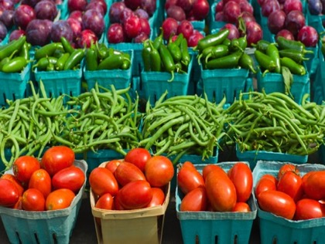

Items in The Basket are weighted
Basket items are weighted to indicate their importance in household spending patterns.
For example, the food and non-alcoholic beverages group made up 17.0% of the CPI in December, 2023.
The bread and cereal products sub-group contributed 1.46%, and fruit and vegetables contributed 2.2% of the CPI – implying that households spend more on ‘fruit and vegetables’ than ‘bread and cereals’ (ABS)
Notes:
What is a weight? Households spend more on some goods and services than others. For example, a 10% increase in the price of petrol will have a much bigger impact on the basket than a similar rise in the price of tea.
December quarter, 2023 data (ABS: Annual weight update of the CPI and Living Cost Indexes). Other countries follow similar methodology.

Slide 7
CPI weights (by group)
Weights rise and fall over time, as household spending patterns change.
Notes:
Prices in the Housing group contribute 22.2% of the total CPI. That is, about a quarter of household spending goes towards items included in the housing group, such as rent; new dwelling purchase costs; maintenance; water rates; electricity, gas charges etc. This means that changes in prices in this group carry account for a higher proportion of the spending pattern of households than, say, the prices of telecommunications services and postal services, both of which fall within the communications group.
Source: ABS: Annual weight update of the CPI and Living Cost Indexes, September quarter, 2023 data. (next update is March 2024)
The weights are now changed every year to reflect changes in household spending patterns. For example, in 2011, the transport group accounted for 11.6% of the CPI; health was 5.3%; communication was 3.1%. The changes reflect changes in household preferences ( e.g. spend more on education); changes in technology (such as that in the communications group); market forces (in the short term, transport rose in 2022 due to the rise in world oil prices); and changes that households make because of price changes (maybe switching from meat to chicken).

Slide 8
calculate the ‘index’ and ‘rate’
 |  | Period 1 (base) |  | Period 2
Item | Weight | $ Price | W x P ($) | $ Price | W x P ($)
Bread | 40 | 3.20 | 128.00 | 3.40 | 136.00
Fish | 30 | 8.00 | 240.00 | 7.80 | 234.00
Lettuce | 20 | 1.15 | 23.00 | 1.20 | 24.00
Chocolate | 10 | 2.50 | 25.00 | 2.80 | 28.00
Total | 100 |  | 416.00 |  | 422.00
 |  | Price index | 100 |  | 101.4
 |  |  | Rate of inflation |  | 1.4%
Step 1 - Multiply weight by price (W x P) for each item
Step 2 – Add the
Expenditure
(W x P) column for period 1
Step 3 – The total spend in period 1 is allocated the index number 100
Step 4 – Repeat steps 1 and 2 for
period 2
Step 5 – Divide total spend in period 2 by total in period 1 to get period 2 index
Step 6 – convert to percentage change over the period
Notes:
Animation uses mouse clicks (6 steps to complete slide)
This slide is a very simple example of how price rises in a four-product economy could be compiled into an index, from which a ‘rate of change’ can be calculated.
Actual weights used for these individual classes in the CPI food and non-alcoholic beverages groups are:
bread 0.56;
fish 0.40;
vegetables 1.28 and
chocolate 0.85.

Slide 9
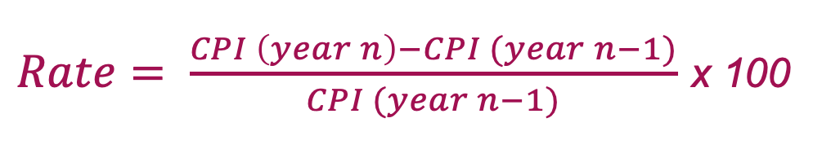
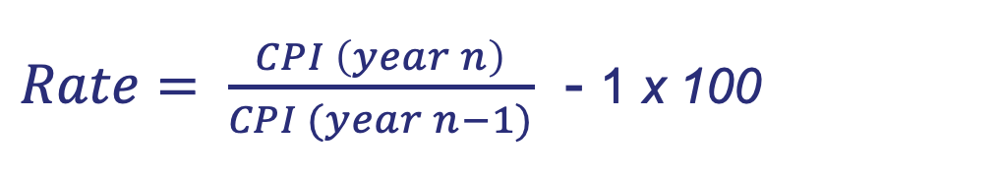
Calculating A rate of change
The rate of change in the CPI is the inflation rate - the rate at which the price level is changing between two periods of time.
Two methods of calculating a rate of inflation from CPI data:
$Rate= \frac{CPI \left(year n\right)−CPI (year n−1)}{CPI (year n−1)}$ x 100
or
$Rate= \frac{CPI \left(year n\right)}{CPI (year n−1)}$ - 1 x 100
Notes:
Year n could be 2022, in which case year n-1 is 2021 (the year before it). Or it could be a three-month period (quarter). For example the March quarter is the three months between December 31 and March 30 of any year.

Slide 10
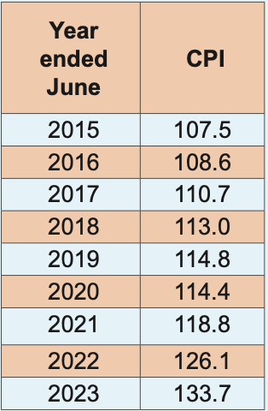
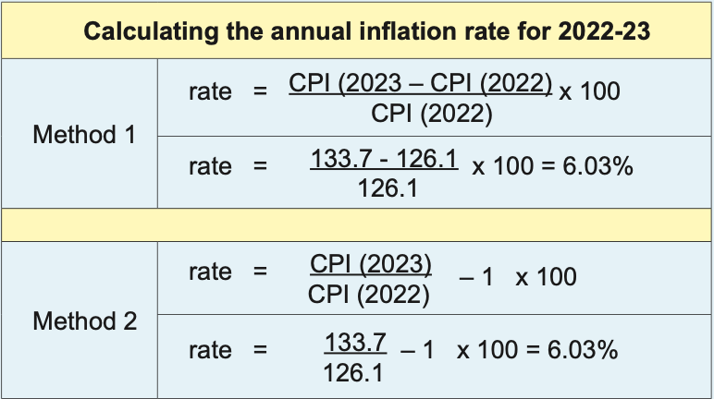
CPI calculation
Notes:
How to calculate the rate of change in the CPI between 2022 and 2023.
Steps for method 1:
Write the formula to indicate you understand the concept (even if using a calculator)
Carefully substitute the CPI numbers
Subtract the second number from the first in the numerator: 133.7-126.1 = 7.6
Divide by the denominator: 7.6 / 126.1 = 6.027
Multiply by 100
Round to one decimal place: 6.0
Include a percent sign: 6.0%
Steps for method 2:
Write a formula
Carefully substitute the CPI data
Divide the numerator by the denominator
Subtract 1
Multiply by 100
Round to one decimal place
Include a percent sign
Redo the calculations with more recent CPI data…

Slide 11
Australian inflation rates
Annual data Year ended June
Over the period 1980 - 2023, the average rate of annual inflation was 4.1%
Notes:
The annual rates in this graph are calculated from June to June.
Note there has been a resurgence in inflation worldwide 2022/23 – see detail in next slides.

Slide 12
inflation since 2015
The line graph shows the annual rate of inflation.
The columns show the quarterly inflation rate.
%
Source: ABS,
Consumer Price Index, Australia
Ref period September 2023
Notes:
Inflation was very low for most of this 2010s decade, rarely rising above 1% per quarter.
Since 2020:
COVID-19 saw inflation fall as prices fell in key areas such as transport (less economic activity leads to less demand for petrol)
Inflationary pressure emerged through 2021 and 2022 due to supply chain issues associated with lockdowns and employee illness
Inflation continued in 2022 as government stimulus to overcome the economic effects of COVID translated to higher spending in some areas (housing) at the same time a supply chain problems (shortages) affected supplies of materials
Food prices rose internationally due to the war in Ukraine
Inflation has forced up interest rates, forcing up the costs of borrowing.
Update the graph from ABS releases.

Slide 13
Inflation by CPI group
Notes:
Students could update the data from the source: ABS: Consumer Price Index, Australia.
Discussion:
Why did prices in the communication CPI group rise so slowly ( and fall in 3 of the years shown? [Competition, technical change, economies of scale]
Which groups saw price falls in the year ended June 2020? Explain.
What factors could have driven up prices in the housing and insurance groups in 2023? What effect would that have had on the cost of living?

Slide 14
International inflation
Country | 2020-21 | 2021-22 | 2022-23 | Country | 2020-21 | 2021-22 | 2022-23
USA | 4.3 | 9.1 | 3.1 | Indonesia | 1.3 | 4.4 | 2.9
Canada | 3.3 | 8.1 | 3.1 | New Zealand | 3.3 | 6.9 | 5.6
France | 0.4 | 5.8 | 3.5 | Greece | -0.5 | 12.1 | 3.0
Germany | 2.8 | 6.7 | 3.2 | South Africa | 3.0 | 7.4 | 5.5
UK | 1.8 | 9.4 | 4.6 | Argentina | 55.4 | 64.0 | 161
Japan | -0.2 | 2.4 | 3.3 | Singapore | 1.0 | 6.7 | 4.7
Source: Trading Economics.
Rates are price changes (%) for June on June in each year
Notes:
Student activity: add latest data for 2023-24.
Suggest why inflation increased over the period – reasons will include supply chain interruptions associated with the pandemic; rising oil prices (themselves affected by ongoing supply chain issues after Covid); rising food prices (especially due to the Invasion of Ukraine which has restricted production and exports of crops from past years; and rising interest rates in many world markets.
What impact would higher rates have on cost of living for households; interest rates on loans and deposits; business decision-making and international trade?

Slide 15
The CPI is A ‘headline’ measure
The CPI is a broad, all-groups measure.
The ABS also calculates underlying measures by removing irregular or extreme price movements.
The underlying measures are the trimmed mean and the weighted median.
Underlying measures give a more accurate picture of inflation by adjusting for seasonality, the volatility of some prices (e.g. fuel, fruit and vegetables) and events affecting some commodities or markets.

Slide 16
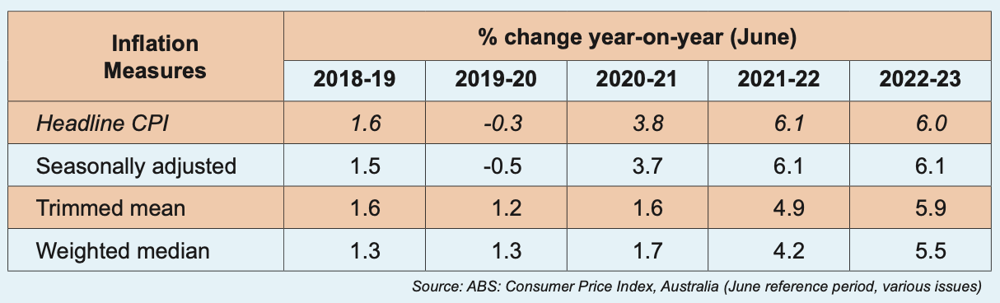
Underlying measures
Notes:
To get a better picture of the ‘true’ rate of inflation, underlying measures are calculated. Doing so adjusts headline data to account for seasonal patterns, and changes in the prices of groups where prices are known to be ‘volatile’, such as fruit and vegetables (e.g. higher prices due to a flood event) and fuel (the price of which is basically determined on world markets).
The Trimmed mean is the the weighted average of the middle 70 per cent of items (the lowest and highest 15% of classes are removed).
The Weighted median is the inflation rate of the item at the middle of the price changes in the CPI basket

Slide 17
Types of inflation
There are two general ‘types’ of inflation:
Demand pull inflation, which explains why prices can increase when there are higher levels of aggregate demand - ‘too much demand chasing too few goods’.
Cost push inflation, which explains why prices increase when rising input prices are passed through to consumer prices.
Notes:
The two ‘types’ are highly generalised, and not mutually exclusive

Slide 18
Demand pull inflation
Demand pull inflation is often associated with a strong economy and the expansion phase of the business cycle, when higher spending tends to ‘bid up’ prices in both product and factor markets (e.g. labour)
Indicators of potential demand pressures include increasing wages; high consumer confidence; lower household saving; higher use of credit.
When the economy is strong:
  there is little spare capacity and unemployment is low, so employers need to offer higher wages to attract and retain employees;
  consumer demand is strong, so the prices of some items will rise, especially if there are shortages or bottlenecks.

Slide 19
Cost push inflation
Cost push inflation occurs when rising input costs are passed on to buyers, such as when:
Higher oil prices feed into fuel costs at the pump;
Currency depreciation increases the prices of imports;
Natural disasters create shortages, forcing up prices;
Supply chain issues occur e.g. Covid-19 in 2021/22;
Prices may rise if middle-east tensions restrict shipping access to the Red Sea and Suez Canal.
Notes:
In practice, cost and demand types of inflation often occur together – e.g. increased demand force prices up, which then flow on to costs of living.
Is rising inflation in 2023 due to demand or cost pressures? Demand may have increased due to pent up spending in COVID-19 and increased borrowing when interest rates were low. There are still parts of the supply chain that are working slower than normal, leading to slower deliveries of building products and cars. Costs have risen as higher inflation led to interest rate rises.

Slide 20
The effects of inflation
Moderate inflation is OK because it reflects a strong economy. Most countries have a 2-3% p.a. ‘target’. Higher rates have significant economic costs:
Interest rates will be forced upwards to retain a positive margin between the nominal interest rate and the inflation rate (i.e. a positive real interest rate)
The burden of inflation falls more on lenders than borrowers as lenders are being paid back inflated dollars
Real purchasing power falls – 4% inflation means $100 today will buy $96 worth of goods a year from now!
Notes:
3 mouse clicks to reveal slide

Slide 21
The effects of inflation
Inflation can harm a country’s competitiveness on overseas markets – if inflation in country A is greater than other countries, A’s exports become more expensive relative to other countries.
Inflation can lead to uncertainty e.g. estimating costs for contracts such as building; deciding whether to invest in plant and equipment
Economic efficiency can suffer if inflation diverts activity from productive to speculative purposes.
The burden of inflation falls more on people on fixed incomes like pensions than those who have the funds to negotiate or speculate!
Notes:
Refer to recent instances in the building industry where prices of materials are rising quickly and cutting profit margins from the signing of building contract to the final delivery of the house 12 – 18 months later.

Slide 22
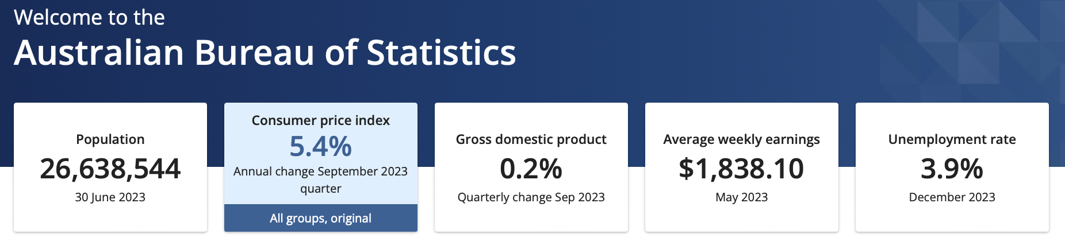
Inflation news
Access the latest inflation news from the ABS website – the quarterly CPI update, and monthly inflation indicators.
Look for headline and underlying rates; CPI by group; and analysis of influences on prices over the period.
Notes:
Access the ABS web site at www.abs.gov.au

Slide 23
ABS Media release
(April 2022)
The Consumer Price Index (CPI) rose 2.1 per cent in the March 2022 quarter and 5.1 per cent annually - the largest quarterly and annual rises since the introduction of the GST in 2020.
The most significant contributors to the annual rise in the CPI were new dwellings (+14 per cent) and automotive fuel (+35 per cent).
Continued shortages of building supplies and labour and ongoing strong demand contributed to price rises . . . while the Ukraine-Russia war pushed the automotive fuel series to record levels.
Identify possible cost and demand factors behind the surge in inflation

Slide 24
Sample news - inflation
July 28, 2021 Now that Australia’s inflation rate is 3.8%. Is it time to worry? (John Hawkins. The Conversation).
April 3, 2022 China’s crisis and inflation could impact Australia’s economy (Tarric Brooker).
April 28, 2022 Reuters: Australian inflation hits 20-yr high (Wayne Cole).
April 6, 2023 ABC: Higher oil prices could fuel inflation (video).
January 2, 2024 Republic World: Red flags from the Red Sea (Rajat Mishra)
Notes:
Please add your own links to more recent articles here.

Slide 25
review
What is always indicated by an increase in the Consumer Prices Index (CPI)?
(a) An increase in consumer spending in an economy.
(b) An increase in living standards.
(c) An increase in the average cost of living.
(d) An increase in the purchasing power of money.

Slide 26
review
Some goods take a greater percentage of a typical household’s total spending than others. How is this accounted for in the construction of a consumer price index?
(a) By deducting the goods.
(b) By giving a weight to the goods.
(c) By taking an average of price fluctuations during a year.
(d) By using the price elasticity of demand for the goods.

Slide 27
review
The two largest categories in the CPI basket are
(a) transport and health.
(b) food and entertainment.
(c) clothing and food.
(d) housing and food.

Slide 28
review
Refer to the values of the Consumer Price Index for year 1 and year 2. The inflation rate for year 2 was equal to
(a) 8.5 percent.
(b) 10 percent.
(c) 2.8 percent.
(d) 3.0 percent.
Year | CPI
1 | 107
2 | 110

Slide 29
review
Refer to the Consumer Price Index data below. The inflation rate over the period shown in the table is
(a) increasing.
(b) decreasing.
C. constant.
(d) indeterminate.
Year | CPI
1 | 100
2 | 104
3 | 108

Slide 30
review
Four groups who are affected by changing economic conditions are creditors, debtors, exporters and importers. Which pair is most likely to be disadvantaged by a high rate of inflation?
(a) creditors and exporters.
(b) creditors and importers.
(c) debtors and exporters.
(d) debtors and importers.

Slide 31
review
A major contributor to cost-push inflationary pressures in the Australian economy in 2022 has been
(a) consumers buying goods and services on credit.
(b) relatively low high interest rates.
(c) increased world oil prices.
(d) increased productivity.

Slide 32

Sources and attribution
The Inflation slide series accompanies ch 9 of Discovering Economics 8th ed, and is licensed under CC BY-NC. This license allows reusers to distribute, remix, adapt, and build upon the material in any medium or format for noncommercial purposes only, and only so long as attribution is given to the creator.
All photos are CC0 Public Domain (free for commercial use – no attribution required). They were accessed from Microsoft stock photos, Unsplash and Pixabay. Graphics on slides 6, 9, 10-12, and 15 are sourced or modified from the Discovering Economics text. All graphs produced from Australian Bureau of Statistics (ABS) data.
Discovering Economics 8th (Greg Parry and Steven Kemp).
ISBN 978-1-875313-65-5. Tactic Publications Pty Ltd
Slide series updated January 2024

